Slide 1

PNEUMONIA CLASSIFIER
DEEP LEARNING

Slide 2

TEAM TECHIES
JAYAKUMAR S – 9920004053
KAMALAKANNAN - 9920004060
MOHAMES SULTAN ISHAQ - 9920004087
PADMANABAN S - 9920004095
Guided by
Mr. R. Raja Subramanian

Slide 3
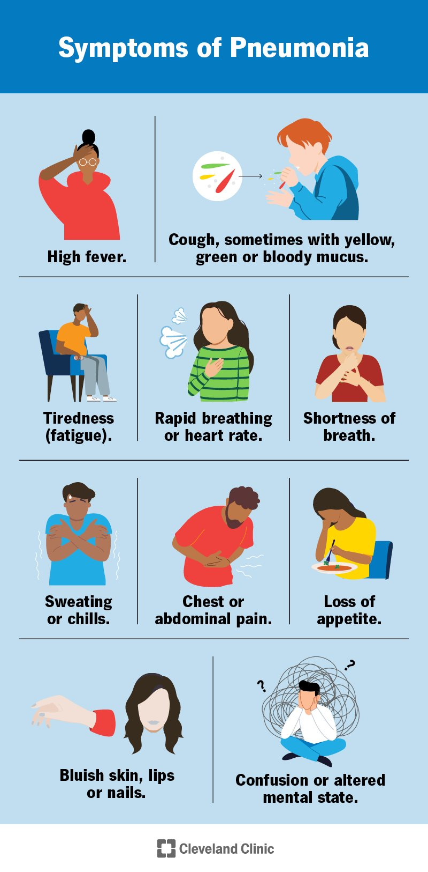
Introduction
Pneumonia is an infection of the lungs that can be caused by bacteria, viruses, or other microorganisms.
Pneumonia can affect people of all ages, but it is more common and can be more serious in young children, the elderly, and people with weakened immune systems.

Slide 4
Timeline
WEEK 1
DATA COLLECTION
WEEK 3
MODEL CREATION
WEEK 5
EVALUATING THE MODELS WITH DIFFERENT OPTIMIZERS
WEEK 2
DATA PREPROCESSING
WEEK 4
VISUALIZING THE MODELS

Slide 5
DATA SET
The pneumonia dataset used in the project consists of a total of 4580 chest X-ray images, which are categorized into three classes: normal, bacterial pneumonia, and viral pneumonia.
The dataset was collected from various sources and preprocessed to ensure the quality and consistency of the images.
The normal class contains chest X-rays of healthy individuals, while the bacterial pneumonia class contains images of patients with pneumonia caused by bacterial infections.

Slide 6
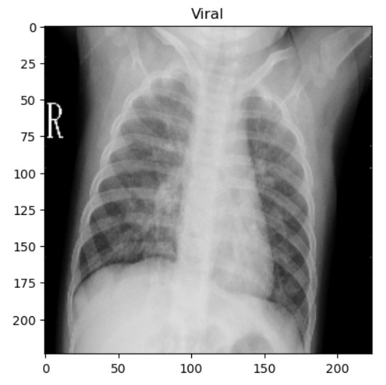
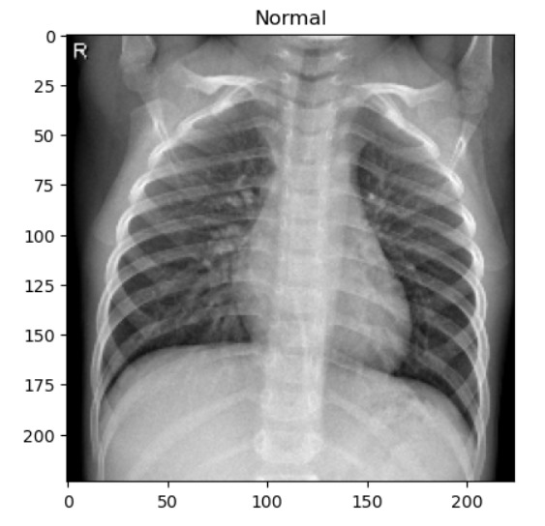
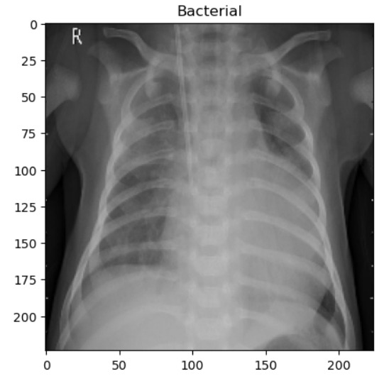
DATA SET CLASSES

Slide 7
Convolutional Neural Network (CNN)
A Convolutional Neural Network (CNN) is a type of artificial neural network that is commonly used for image classification, object detection, and other computer vision tasks.
CNNs are based on the idea of convolution, which is a mathematical operation that involves sliding a small matrix (known as a filter or kernel) over an input image to extract features.
CNNs have been shown to achieve state-of-the-art performance on a wide range of computer vision tasks, including image classification, object detection, facial recognition, and more. They are widely used in industries such as self-driving cars, robotics, and medical imaging.

Slide 8
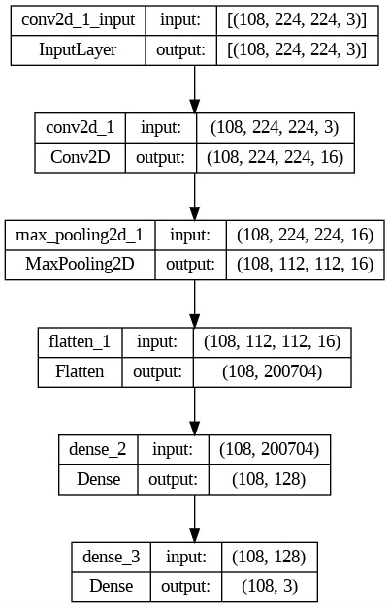
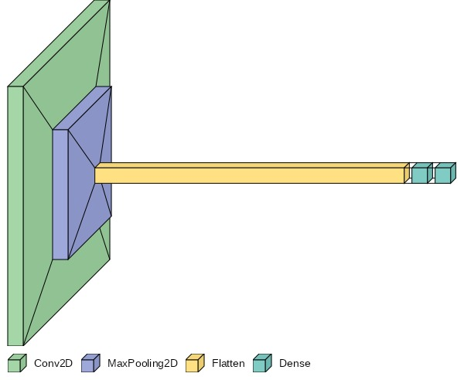
SIMPLE CNN MODEL

Slide 9
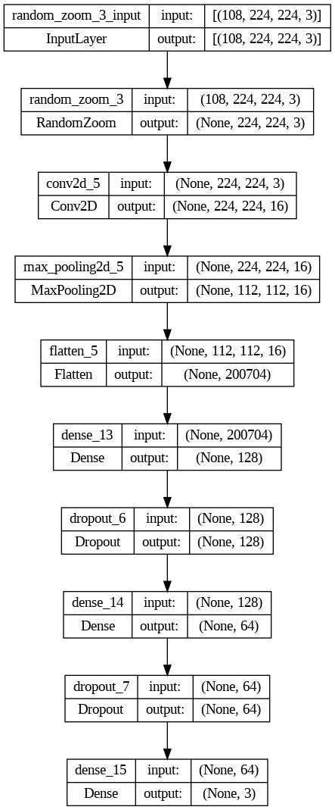
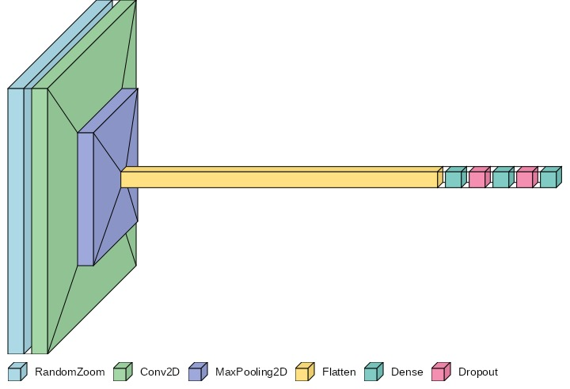
CNN Model With Data Augmentation layers and Dropout layers

Slide 10
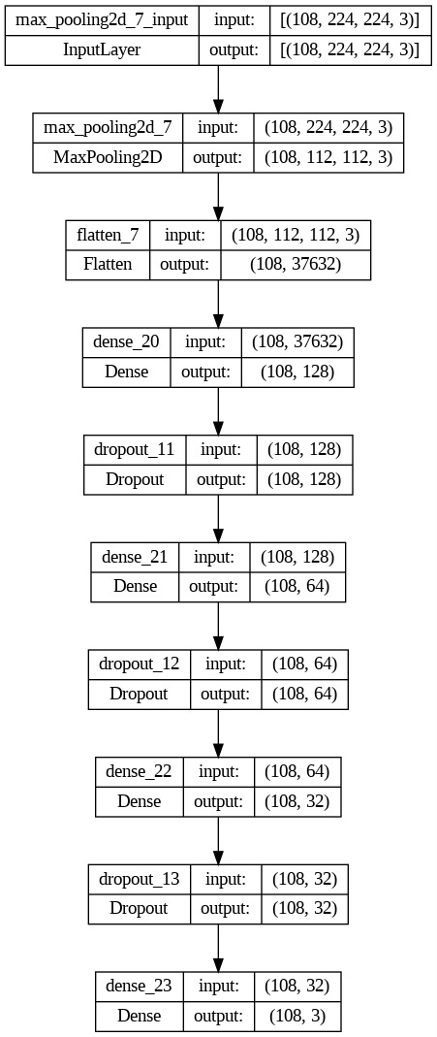
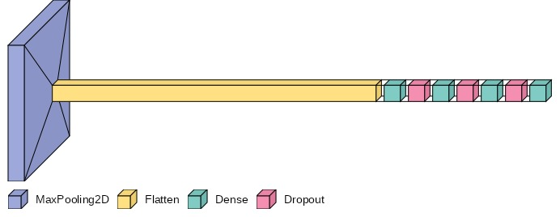
CNN Model with only Dropout layers

Slide 11
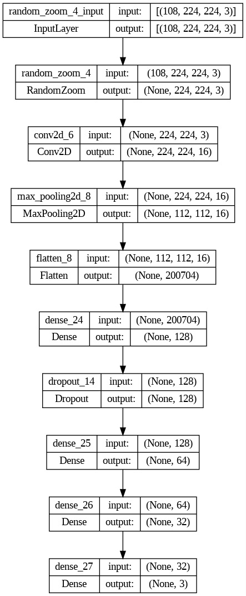

CNN Model only with Augmentation layers

Slide 12
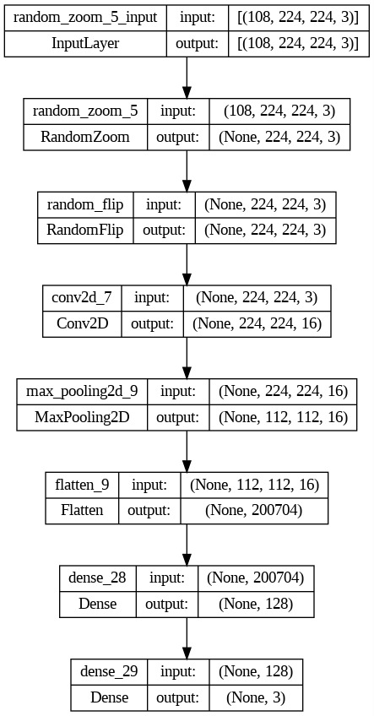
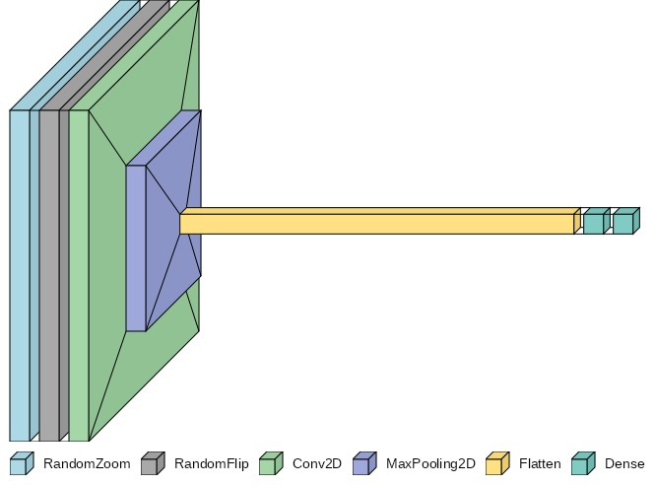
CNN Model with two different augmentation layers

Slide 13
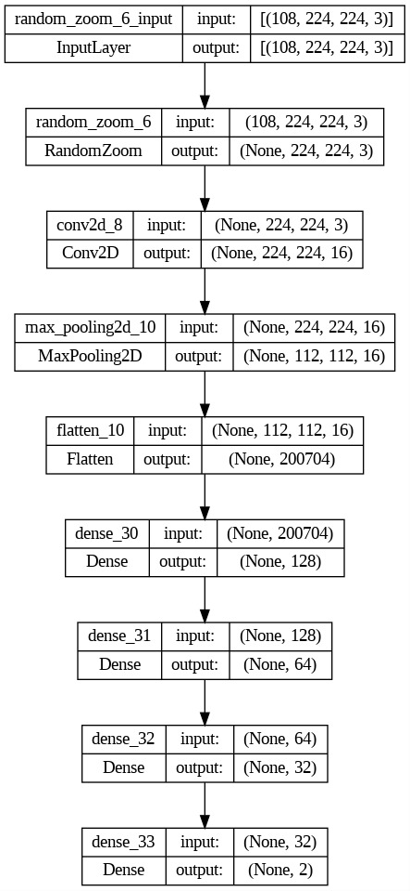
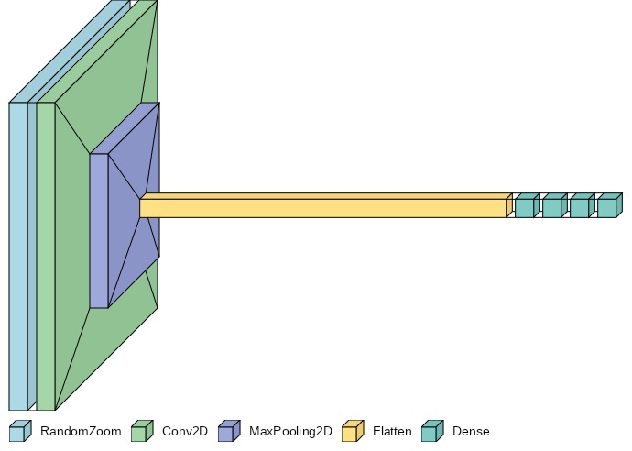
CNN Model with Data Augmentation layer and more dense layers

Slide 14
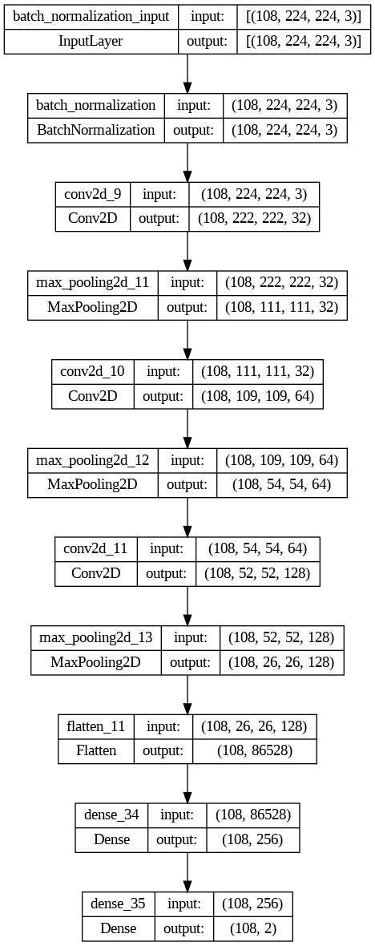
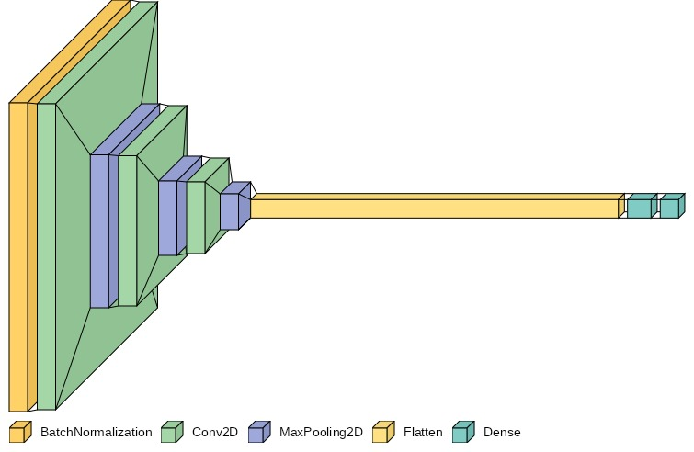
CNN Model that uses Filters in all the Layers

Slide 15
OPTIMIZERS USED
ADAM
ADAMAX
RMSProp
SGD
ADADELTA

Slide 16
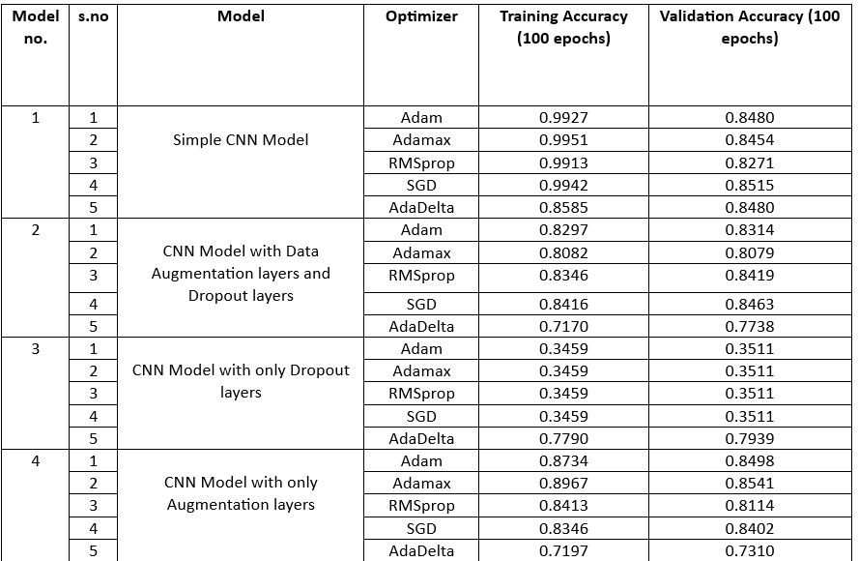
MODEL EVALUATION

Slide 17
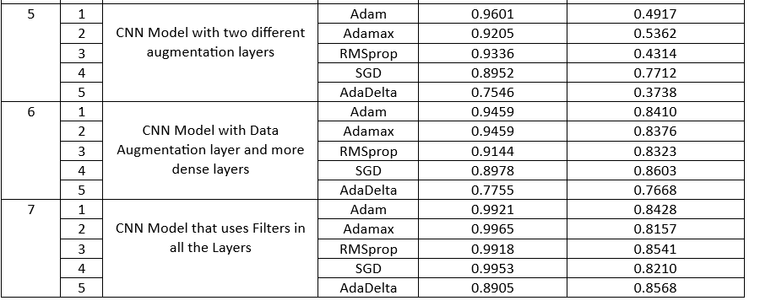

Slide 18
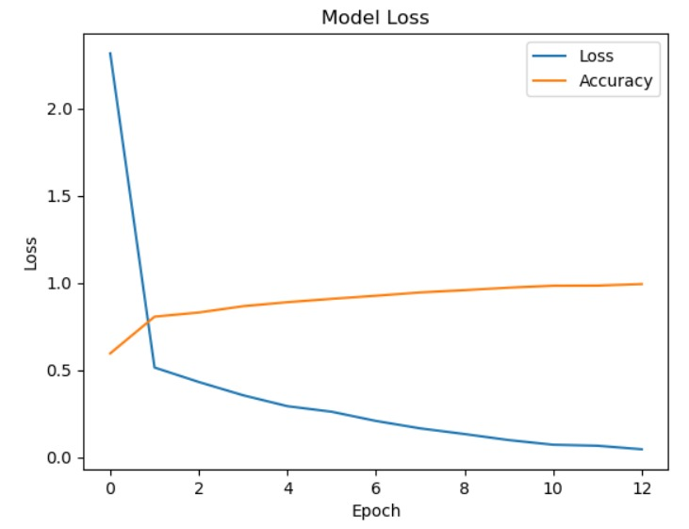
RESULT
we conclude that the simple CNN model and the CNN model with filters on each of the layer has maximum accuracy and performance which means it’ll be effective when we go for classification with real time images in the future.

